Slide 1


Cloud Computing and Security
BIS613D
Module 5
Cloud Programming and Software Environments
Department of ISE

Slide 2
Hadoop Library from Apache
Hadoop is an open source implementation of MapReduce coded and released in Java (rather than C) by Apache.
The Hadoop implementation of MapReduce uses the Hadoop Distributed File System (HDFS) as its underlying layer rather than GFS
The Hadoop core is divided into two fundamental layers: the MapReduce engine and HDFS
The MapReduce engine is the computation engine running on top of HDFS as its data storage manager.
Playing of Short Hadoop Video

Slide 3
Hadoop Library from Apache
HDFS has a master/slave architecture containing a single NameNode as the master and a number of DataNodes as workers (slaves).
To store a file in this architecture, HDFS splits the file into fixed-size blocks (e.g., 64 MB) and stores them on workers (DataNodes).
The mapping of blocks to DataNodes is determined by the NameNode.
The NameNode (master) also manages the file system’s metadata and namespace.
In such systems, the namespace is the area maintaining the metadata, and metadata refers to all the information stored by a file system that is needed for overall management of all files.
For example, NameNode in the metadata stores all information regarding the location of input splits/blocks in all DataNodes.
Each DataNode, usually one per node in a cluster, manages the storage attached to the node.
Each DataNode is responsible for storing and retrieving its file blocks

Slide 4
Hadoop Architecture
The topmost layer of Hadoop is the MapReduce engine that manages the data flow and control flow of MapReduce jobs over distributed computing systems.
Similar to HDFS, the MapReduce engine also has a master/slave architecture consisting of a single JobTracker as the master and a number of TaskTrackers as the slaves (workers).
The JobTracker manages the MapReduce job over a cluster and is responsible for monitoring jobs and assigning tasks to TaskTrackers.
Each TaskTracker node has a number of simultaneous execution slots, each executing either a map or a reduce task.
Slots are defined as the number of simultaneous threads supported by CPUs of the TaskTracker node.
For example, a TaskTracker node with N CPUs, each supporting M threads, has M * N simultaneous execution slots.
It is worth noting that each data block is processed by one map task running on a single slot.
Therefore, there is a one-to-one correspondence between map tasks in a TaskTracker and data blocks in the respective DataNode.

Slide 5
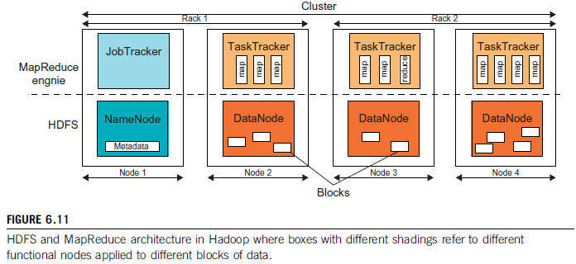

Slide 6
Characteristics of HDFS
HDFS Fault Tolerance: HDFS is not a general-purpose file system, as it only executes specific types of applications, it does not need all the requirements of a general distributed file system
  Block replication – HDFS stores a file as a set of blocks and each block is replicated and distributed across the whole cluster. The replication factor is set by the user and is three by default.
  Replica placement – The placement of replicas is another factor to fulfill the desired fault tolerance in HDFS. HDFS stores one replica in the same node the original data is stored, one replica on a different node but in the same rack, and one replica on a different node in a different rack to provide three copies of the data
  Heartbeat and Blockreport messages – Heartbeats and Blockreports are periodic messages sent to the NameNode by each DataNode in a cluster

Slide 7
Characteristics of HDFS
HDFS High-Throughput Access to Large Data Sets (Files): Primarily designed for batch processing, data access throughput in HDFS is more important than latency.
  Two advantages:
  The list of blocks per file will shrink as the size of individual blocks increases,
  And by keeping large amounts of data sequentially within a block, HDFS provides fast streaming reads of data.

Slide 8
Characteristics of HDFS
HDFS Operation: Control flow of HDFS operations such as write and read can properly highlight roles of the NameNode and DataNodes in the managing operations
  Reading from a File –
  To read a file in HDFS, a user sends an “open” request to the NameNode to get the location of file blocks.
  For each file block, the NameNode returns the address of a set of DataNodes containing replica information for the requested file.
  Upon receiving such information, the user calls the read function to connect to the closest DataNode containing the first block of the file.
  Connection is terminated and the same process is repeated for all blocks of the requested file until the whole file is streamed to the user.

Slide 9
Characteristics of HDFS
HDFS Operation: Control flow of HDFS operations such as write and read can properly highlight roles of the NameNode and DataNodes in the managing operations
  Writing to a File –
  To write a file in HDFS, a user sends a “create” request to the NameNode to create a new file in the file system namespace.
  If the file does not exist, the NameNode notifies the user and allows him to start writing data to the file by calling the write function.
  The first block of the file is written to an internal queue termed the data queue while a data streamer monitors its writing into a DataNode.
  Since each file block needs to be replicated by a predefined factor, the data streamer first sends a request to the NameNode to get a list of suitable DataNodes to store replicas of the first block.

Slide 10
Running a Job in Hadoop
Job Submission
  Each job is submitted from a user node to the JobTracker node that might be situated in a different node within the cluster through the following procedure:
  A user node asks for a new job ID from the JobTracker and computes input file splits.
  The user node copies some resources, such as the job’s JAR file, configuration file, and computed input splits, to the JobTracker’s file system.
  The user node submits the job to the JobTracker by calling the submitJob() function.

Slide 11
Running a Job in Hadoop
Task assignment
  The JobTracker creates one map task for each computed input split by the user node and assigns the map tasks to the execution slots of the TaskTrackers.
  The JobTracker considers the localization of the data when assigning the map tasks to the TaskTrackers.
  The JobTracker also creates reduce tasks and assigns them to the TaskTrackers.
  The number of reduce tasks is predetermined by the user, and there is no locality consideration in assigning them.
Task execution The control flow to execute a task (either map or reduce) starts inside the TaskTracker by copying the job JAR file to its file system. Instructions inside the job JAR file are executed after launching a Java Virtual Machine (JVM) to run its map or reduce task.
Task running check A task running check is performed by receiving periodic heartbeat messages to the JobTracker from the TaskTrackers. Each heartbeat notifies the JobTracker that the sending TaskTracker is alive, and whether the sending TaskTracker is ready to run a new task.

Slide 12
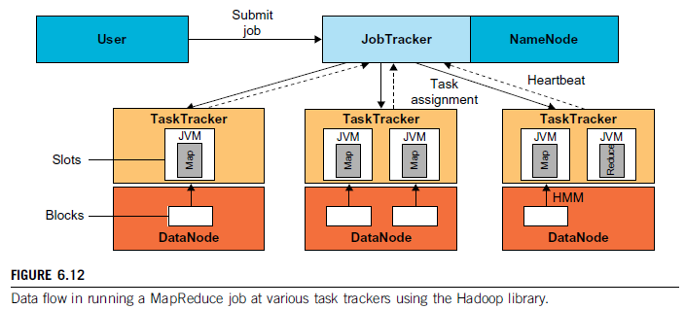

Slide 13
.
THANK YOU

